Slide 1
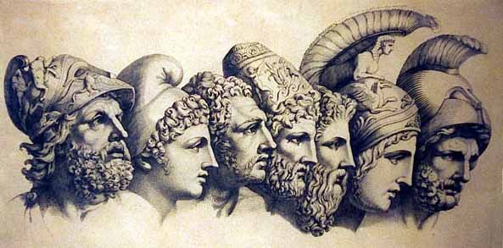
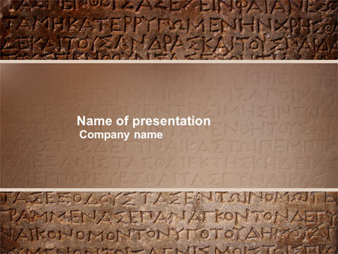
Greek Mythology Group 6
10442001 廖于慧
10442005 陳儀樺
10442014 陳香羽
10442017 簡詩庭
10442019 林姿羽
10447011 翁郁雯
10447012 楊子儀10447021 張德容

Slide 2
Hercules

Slide 3
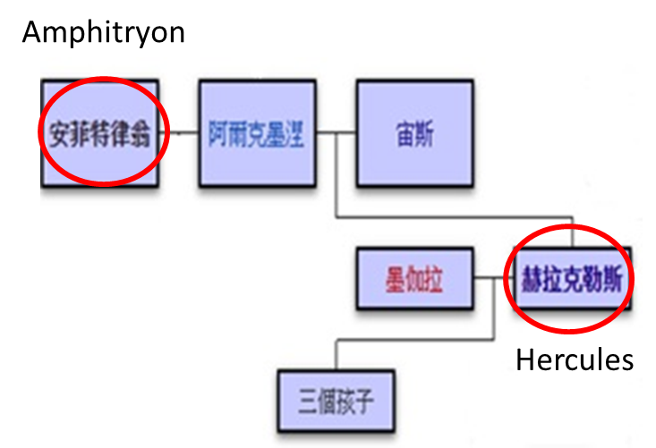
Characters-Amphitryon
關係圖
Notes:
他回到底比斯的前一天晚上，宙斯變成了他的模樣與阿爾克墨涅交合。二人很迷惑，詢問底比斯城裡的先知特瑞西阿斯，特瑞西阿斯向他們透露勒宙斯的行為，而且預言他們將會擁有一個不朽的兒子——赫拉克勒斯。後來阿爾克墨涅生下雙胞胎，赫拉克勒斯和伊菲克勒斯，前者是宙斯的兒子，後者是安菲特律翁的兒子

Slide 4
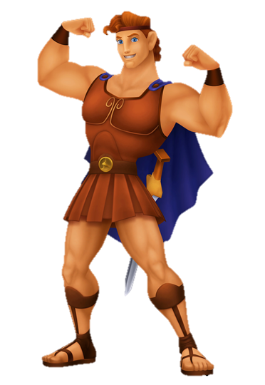
Characters-Hercules
Hercules is the Roman adaptation of the Greek divine hero Heracles, who was the son of Zeus (Roman equivalent Jupiter) and the mortal Alcmene.
In classical mythology, Hercules is famous for his strength and for his numerous far-ranging adventures.
The Romans adapted the Greek hero's
iconography and myths for their literature
and art under the name Hercules.
In later Western art and literature and in popular culture, Hercules is more commonly used than
Heracles as the name of the hero.

Slide 5
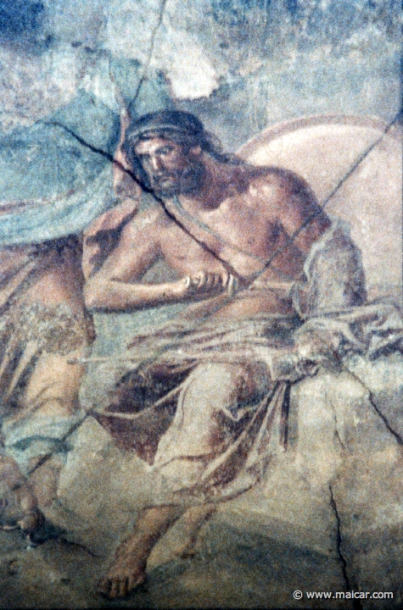
Characters-Amphitryon
Amphitryon was a Theban general, who was originally from Tiryns in the eastern part of the Peloponnese. He was friends with Panopeus.
He fell in battle against the Minyans, against whom he had undertaken an expedition, accompanied by the youthful Heracles, to deliver Thebes from a disgraceful tribute. In the play Heracles by Euripides, Amphitryon survives to witness the murders of Heracles' children and wife.
Notes:
他回到底比斯的前一天晚上，宙斯變成了他的模樣與阿爾克墨涅交合。二人很迷惑，詢問底比斯城裡的先知特瑞西阿斯，特瑞西阿斯向他們透露勒宙斯的行為，而且預言他們將會擁有一個不朽的兒子——赫拉克勒斯。後來阿爾克墨涅生下雙胞胎，赫拉克勒斯和伊菲克勒斯，前者是宙斯的兒子，後者是安菲特律翁的兒子

Slide 6
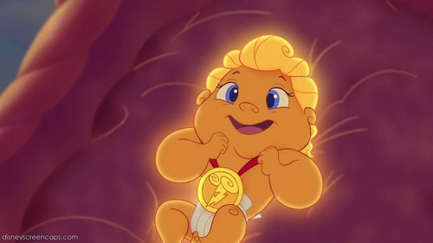
Early Life
Hercules was born in Thebes and his mortal father was Amphitryon, a distinguished general and his mother was Alcmena .
He was the son of Zeus, who had visited Alcmenain the shap of her husband when the general was away fighting.

Slide 7
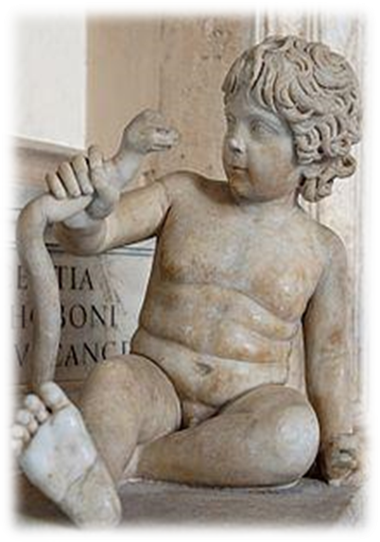
Early Life
Hera, the wife of Zeus, was always jealous of Hercules and made life difficult for him from an early age. She sent two snakes to kill the new-born Hercules, but the baby easily strangled them.

Slide 8
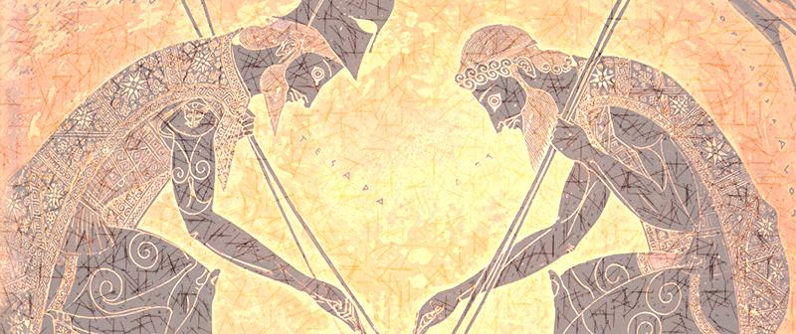
Early Life
Teiresias, the blind prophet of Thebes, told Alcmenain : ‘‘I swear that many a Greek woman as she cards the wool at eventide shall sing of this your son and you who bore him. He shall be the hero of all mankind.’’

Slide 9
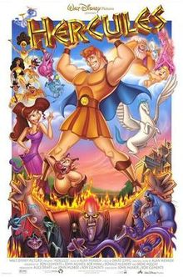
the labors of Hercules
Hercules found himself in his bloodstained hall, the dead bodies of his sons and his wife beside him.
No idea what had happened, how they had been killed.
He had to know how this horror had come to pass and Amphitryon told him.
This miracle ─ it was nothing less ─ of recalling Hercules, from frenzied feeling and violent action to sober reason and sorrowful acceptance, was not wrought by a god descending from the sky.

Slide 10
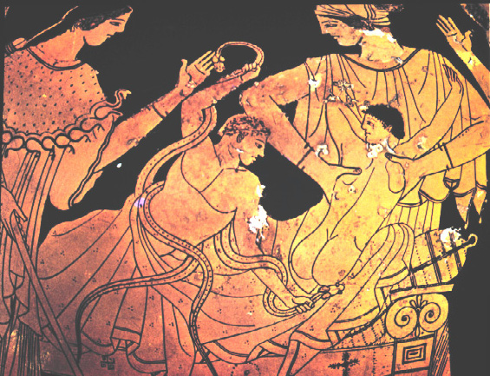
the labors of Hercules
“Men great of soul can bear the blows of heaven and not flinch.”Amphitryon told Hercules.“Everywhere my jailers, the sharp scorpions of the tongue. ”
The god's oracle told him he would have to serve Eurystheus, the king of Tiryns and Mycenae, for twelve years, in punishment for the murders.
The tasks Eurystheus gave him to do
are called“the Labors of Hercules”.
Notes:
*隱申含意：九牛二虎之力

Slide 11
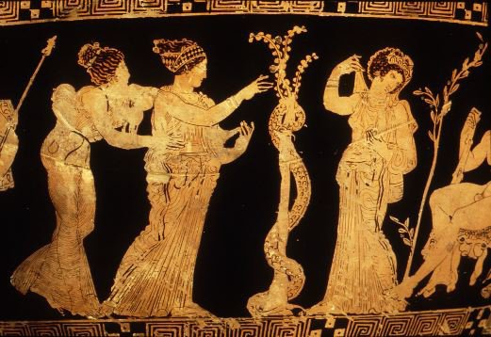
The Golden Apples of the Hesperides
Atlas, who bore the vault of heaven upon his shoulder , was the father of the Hesperides, so Hercules went the him and him to get the apples for him.

Slide 12
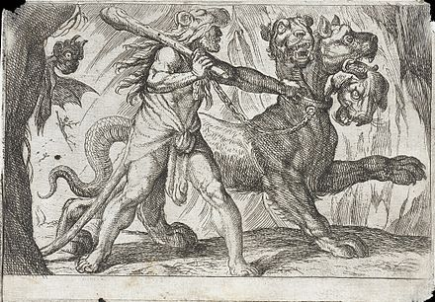
Bring Cerberus
Hercules’s task was to bring Cerberus, the three-headed dog, up from Hade. Pluto gave him permission provided Hercules used no weapons to overcome him.

Slide 13
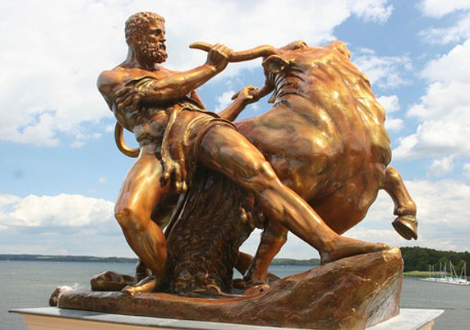
The Cretan Bull
Hercules went to Crete to capture a rampaging bull that had impregnated the wife of the island’s king.
Hercules drove the bull back to Eurystheus, who released it into the streets of Marathon.
(She later gave birth to the Minotaur, a creature with a man’s body and a bull’s head.)

Slide 14
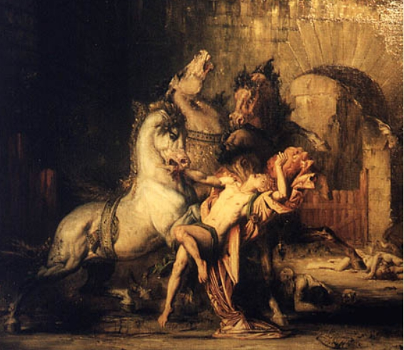
The Horses of Diomedes
Hercules’ eighth challenge was to capture the four man-eating horses of the Thracian king Diomedes. He brought them to Eurystheus, who dedicated the horses to Hera and set them free.

Slide 15
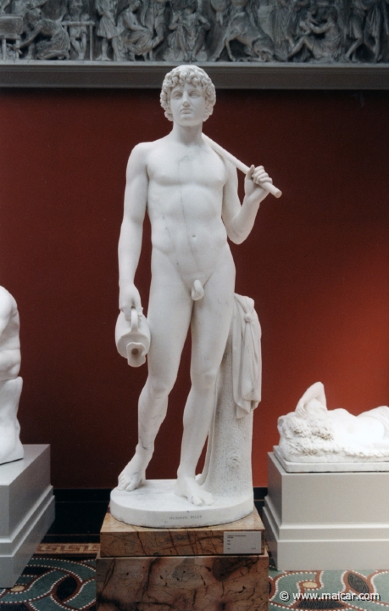
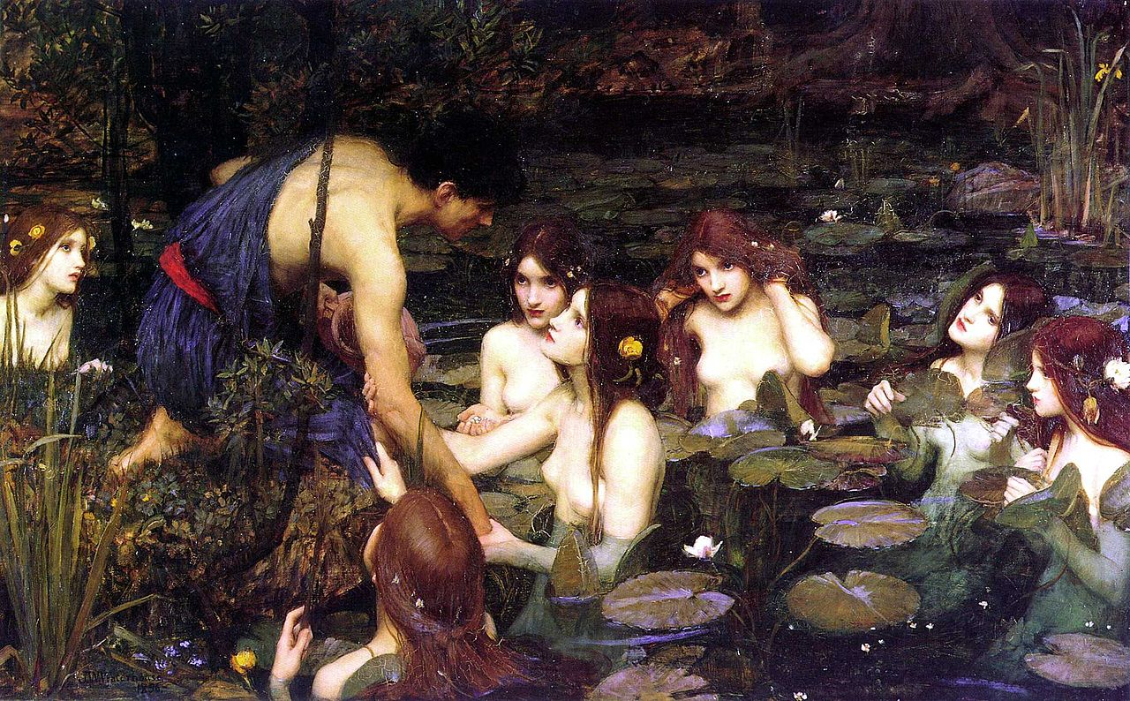
Hylas
In classical mythology, Hylas was a youth who served as
Heracles' companion and lover.His abduction by water ny-
mphs was a theme of ancient art, and has been an endur-
Ing subject for Western art in the classical tradition.

Slide 16
The foolish things Hercules done.
Once Hercules was too hot he pointed an arrow at the sun and threatened to shoot him.
Another time when he boat he was in tossed about by the waves, so he told the waters that he would punish them if they didn’t grow clam.
In conclusion, Hercules wasn’t an intelligent person, and he was often conspicuously absent.

Slide 17
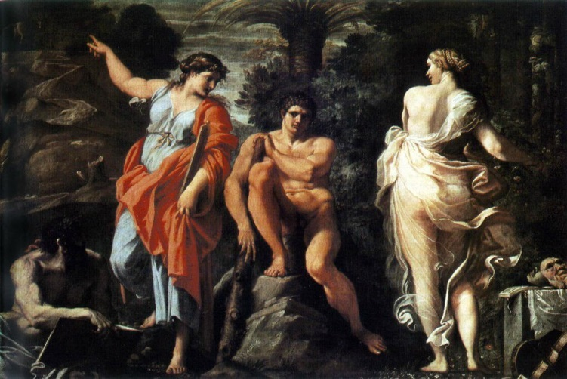
What does make Hercules feel so hopeless?
He deserted the Argo and forgot all about his comrades.
The Quest of the Golden Fleece in his despairing grief at losing his young armor-bearer, Hylas.
Thus, he had sudden outbursts of furious anger which were always fatal to the often innocent objects.
Notes:
Beforehand we have told about his intelligence, we can know that his intellect wasn’t strong, but his emotions were.

Slide 18
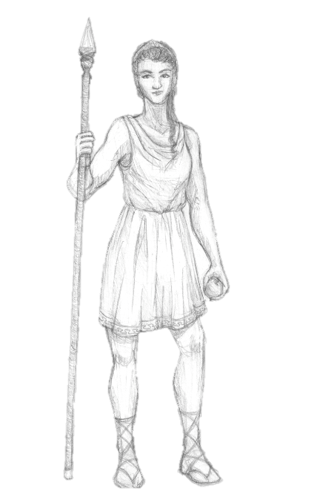
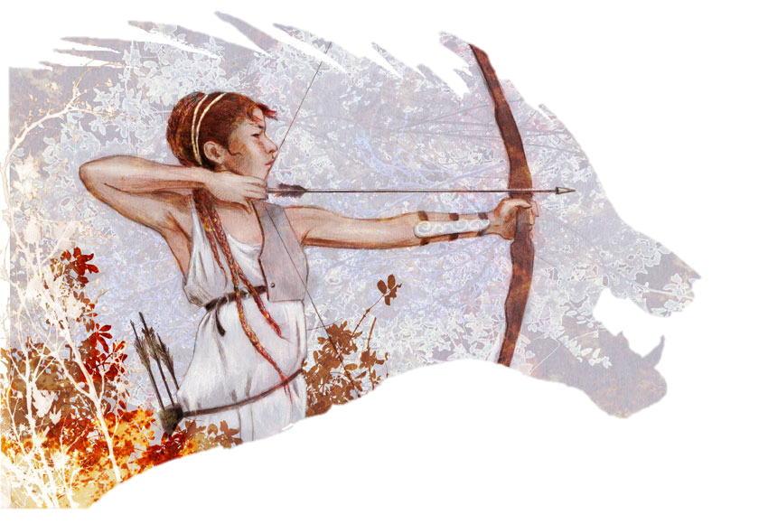
Atalanta

Slide 19
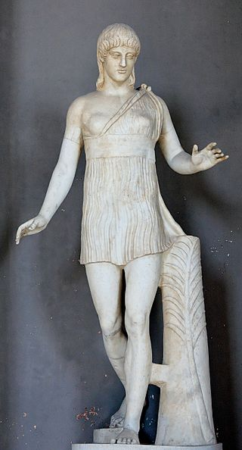
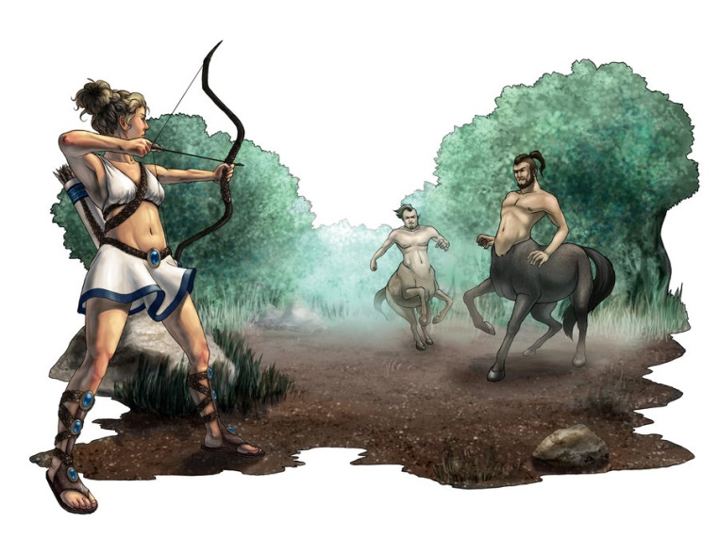
Atalanta’s life
A character in Greek mythology
Two heroines called Atalanta
was abandoned when she was born
grew up fortunately

Slide 20
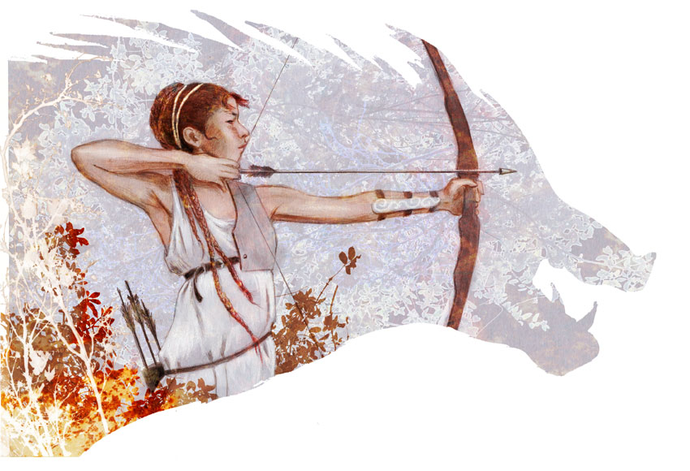
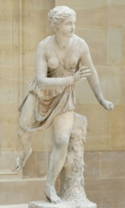
Atalanta’s life
A huntress
Good at surry
Unwilling to marry
Take an oath to Artemis
Her name means “equal in weight”

Slide 21
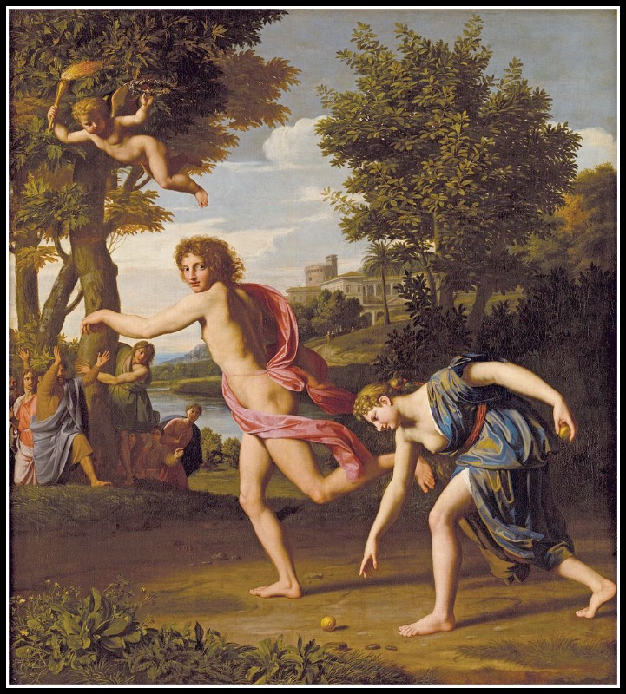
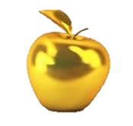
Footrace
King Schoeneus wanted Atalanta to be married.
She agreed only if her suitors could outrun her in a footrace.
Hippomenes was given three golden apples from Aphrodite.

Slide 22
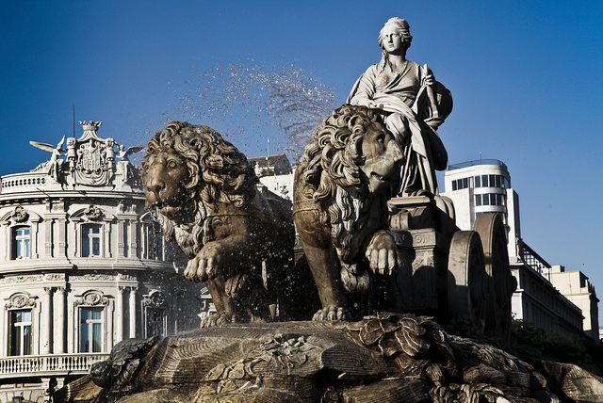
Footrace
Aphrodite changed them into lions.

Slide 23
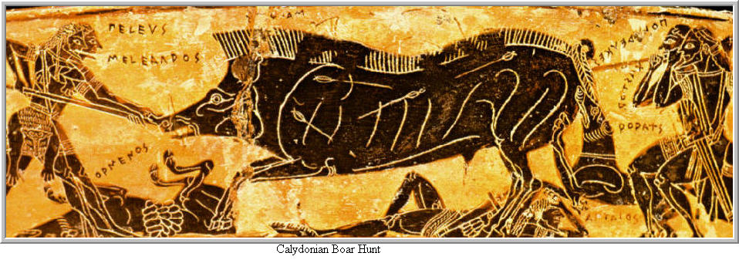
Calydonian Boar Hunt
Oeneus forgot to make a sacrifice to the goddess of the hunt, Artemis.

Slide 24
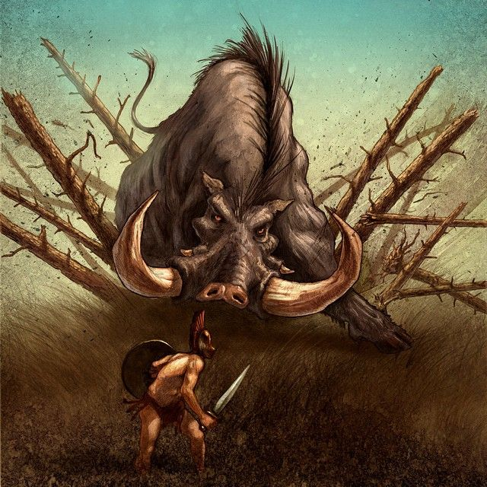
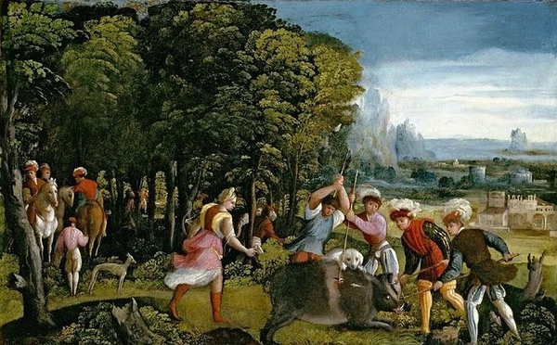
Calydonian Boar Hunt
Artemis sent a boar to punish him
his son Meleager and a fearless woman, Atalanta replied Oeneus’s call.

Slide 25
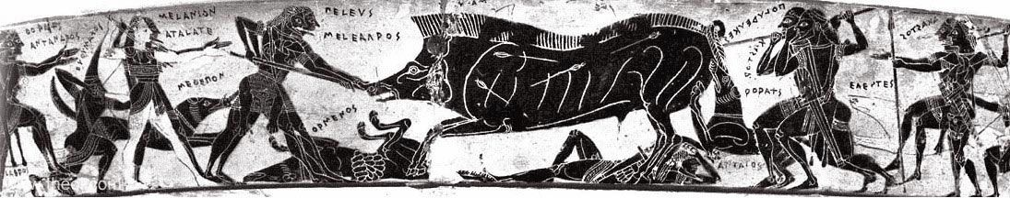
Calydonian Boar Hunt
Atlanta the first blow to the beast, driving an arrow through its skin, and thus triggering its eventual death.
Meleager, who had fallen in love with Atalanta, said that she should get the pelt of the boar.

Slide 26
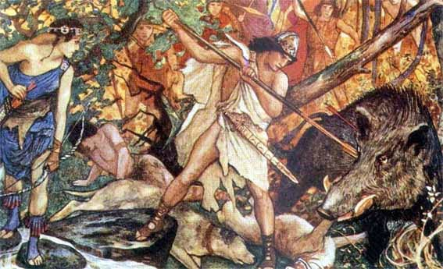
Calydonian Boar Hunt
But his uncles were angry and tried to take the skin from her.
In revenge, Meleager killed his uncles.
When his mother learned what had happened, she burned the log.

